Slide 1


DNL : Do Not Leak
ECSE205L - Spring 2020
Abhinav Robinson E18CSE006
Ashok Kumar E18CSE029
Bhavya Batra E18CSE035
Srishti Verma E18CSE181

Slide 2

Contents
Our Big Idea
The Problem Statement
Solution
Statistical Data
The Concept
Our Product

Slide 3

Introduction
Data Leakage/Loss is one of the major issues that we face on a regular basis.
Data Leakage Investigation as it implies is, to detect the point at which there is loss of data and to provide a strong proof that it's being lost from that point and try to find a patch for it.
This service is built to monitor a specific website or a server for the main aspect.

Slide 4
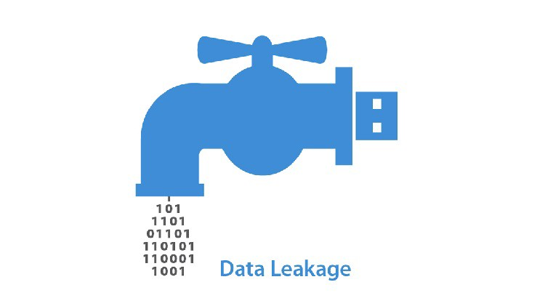
Problem
In course of Business, there is a lot of data generated. Over the internet, during transmission there may be security risks involved in form of a Data Leak, protection of which is important!

Slide 5
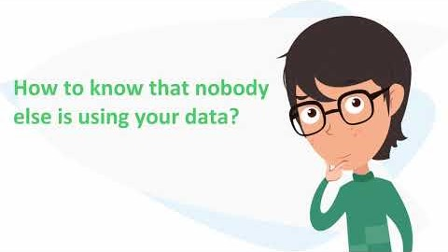

Slide 6

Solution
This project aims to find the weak holes of a server or database, by analyzing the data flow and using probability.
We hope to catch anyone, who is using the data for unfruitful purposes and where the data is being lost.
We will also provide algorithms that do a rerun of the data tracks every time there is a leak detected in order to see where the data goes further.

Slide 7

Goals
. | Goal or Objective
1 | Make the system User Friendly.
2 | Data allocation strategies with high probability of leakage identification.
3 | Detection of when the data has been leaked and by whom
4 | Meet the changing needs and desires of clients and consumers.
5 | Practice high ethical standards.
6 | Provide better customer service.

Slide 8

Stakeholders
Stakeholder | Role
Business Partners | Investors.
Customers | End Users, who secure their data with our service
Faculty | Instructor/Mentor
Dev Team | Development / Bug Fixing / Testing
Legal Team | To maintain and prevent any legal issues that arise, due to the data privacy policies.

Slide 9

Project Resources
Resource | Resource Description | Quantity
Database Server | A database server provided by the sponsoring company. | 1
Capstone Team | Our team of students who will be the primary developers of the project. | 4
Dr. Anurag Gauswami | The mentor who will be able to provide us with technical assistance. | 1
Mac Workstation | Macbook for developing IOS/MacOS side app. | 1
Windows Workstation | Windows machines for developing the windows app. | 3

Slide 10

Users
USERS
Developer
System Admin
Security Admin
Remote Developer
End Users

Slide 11

ROLES
User | Description
Developer | A seasoned developer who is tasked with initial front-end, back-end and ultimately generating a firm process for applying these techniques to future server data.
System Admin | A developer who is tasked with managing system working and essential management roles such as viewing auto-generated reports, system logs and user queries.
Security Admin | A developer tasked with the job to (1) explore new security systems (2) discover flaws in old models and patch them out (3) view system logs to check if anything seems out of place (hacked/modified data)
Remote Developer | Considering the current world scenario, all of our team are working from home.
End Users | The end users, who use the data. We keep a track on the data that pertains to the company and used by the end users.

Slide 12

User stories
ID | Feature name | Story points
1 | Register Systems | 6
2 | Systems Logging and Reports | 6
3 | User Data Management | 3
4 | Data Encryption Systems (except middleware) | 8
5 | User Query System (Feedback and Helpline) | 3
6 | Front-End Development (Web page + WebApp) | 6
7 | Application Development | 5
8 | Middleware Systems | 7
 | TOTAL | 44

Slide 13
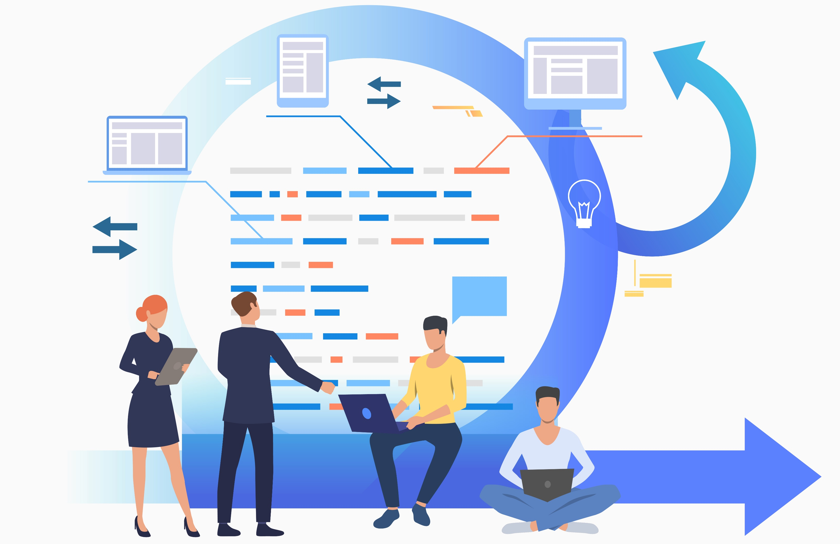
SPRINTS

Slide 14
Sprint 1 Estimated User Story Points: 5 Actual Completed User Story Points: 7
ID | Added | Description | Status | Story Points | Actual Equivalent Story Points | % Completed
100 | Onset | As a End User, I want to be able to register online, So that I can register quickly and access the service | C | 2 | 3 | 100%
101 | Onset | As a End User, I want to be able to log-in online, So that I can quickly access the service if i am already registered | C | 2 | 3 | 100%
102 | Onset | As a System Admin, I want to be able to log-in as a admin So that I can keep track of existing users and new users. | C | 1 | 1 | 100%

Slide 15
Acceptance Criteria |  | Verification
110 | A user cannot submit a form without completing all the mandatory fields | Create a test case to verify non-empty fields.
111 | Information from the form shall be stored in the registration database after form submission | Create a test case to verify information is stored in the database.
112 | Payment shall be accepted via credit card | Create a test case to verify the credit card payment method from the bank.
113 | An acknowledgment email shall be sent to the user after submitting the form. | Create test cases to verify sending of acknowledgement email after successful payment.
ID | Tasks | Resource
1 | Create a registration page with all required fields (FName, LName, organization, Address details, email, credit card details, Username, Password) and register button at the bottom, also have the same for Admin | Team member 1
2 | Create a registration page with all required fields (Username and Password) and Login button at the bottom. | Team member 2
3 | Develop a backend functionality that checks required fields are non-empty when the user clicks on register button. | Team member 3
4 | Built a functionality which verifies payment from bank based on credit card details at 1. | Team member 4
5 | Built a functionality which stores registration data in the database according to the specifications and sends acknowledgement email to the registered email else display payment failure message. | Team member 5

Slide 16
Sprint 2
Estimated User Story Points: 10
Actual Completed User Story Points: 14
ID | Added | Description | Status | Story Points | Actual Equivalent Story Points | % Completed
200 | Onset | As a End User, I want to be able to download the app from the website So that I can launch the app locally | C | 2 | 4 | 100%
201 | Onset | As a End User, I want to be able to query from the website So that I can ask any query that I may face regarding the usage of the software | C | 2 | 2 | 100%
202 | Onset | As a End User, I want to use the service So that I can encrypt my data | C | 4 | 6 | 100%
203 | Onset | As a System Admin, I want to be able to view who is registered So that I can keep track of existing users and new users. | C | 2 | 2 | 100%

Slide 17
Acceptance Criteria |  | Verification
210 | Website successfully identifies the client platform and prepares application download. | Create Test cases that verify downloads for each Major OS platform.
211 | A Query section exists for customers to successfully interact with Support Staff. | Create a Usability test for the Query Section on the Website.
212 | Customer successfully launches the app and is able to Encrypt/Secure their data connection. | Usability test to determine if customers can use the platform successfully. Create Test Cases for major bottleneck scenarios for encryption of data.
213 | System successfully generated a log of all users registered by the form. | Create test cases for creating system logs in for all types of registrations.
ID | Tasks | Resource
1 | Developed a system which automatically detects the host OS platform and prepares the download for them, with a click of the Download Button. | Team member 1
2 | Developed the Back-End for the Query System. | Team member 2
3 | Integrated and Developed the UI for the Query System in accordance to modern UI/UX standards. | Team member 2
4 | Developed the essentials of the Encryption System that secured the User Data Connection. | Team member 3
5 | Developed a system which logs Error/Lost data information and registered User data. | Team member 5

Slide 18
Sprint 3
Estimated User Story Points: 15
Actual Completed User Story Points: 15
ID | Added | Description | Status | Story Points | Actual Equivalent Story Points | % Completed
300 | Onset | As a End User, I want to use this service, So that I can secure my data connection. | C | 15 | 6 | 100%
Acceptance Criteria |  |  | Verification
310 | User Downstream Data must be encrypted from our servers. |  | Create test cases to verify search results by quiz name.
311 | User Upstream Data must be encrypted from our servers. |  | Create test cases to verify search results by quiz topics.
312 | Our servers must have a Firewall to protect them from Cyber Attacks. |  | Create test cases to verify search results by creation and last used date.

Slide 19
Sprint 3 Team Tasks
ID | Tasks | Resource
1 | User Downstream Data Encryption setup (AES-256) | Team member 1
2 | User Upstream Encryption setup (AES-256) | Team member 2
3 | Incorporation of a third-party security vendor. | Team member 3

Slide 20
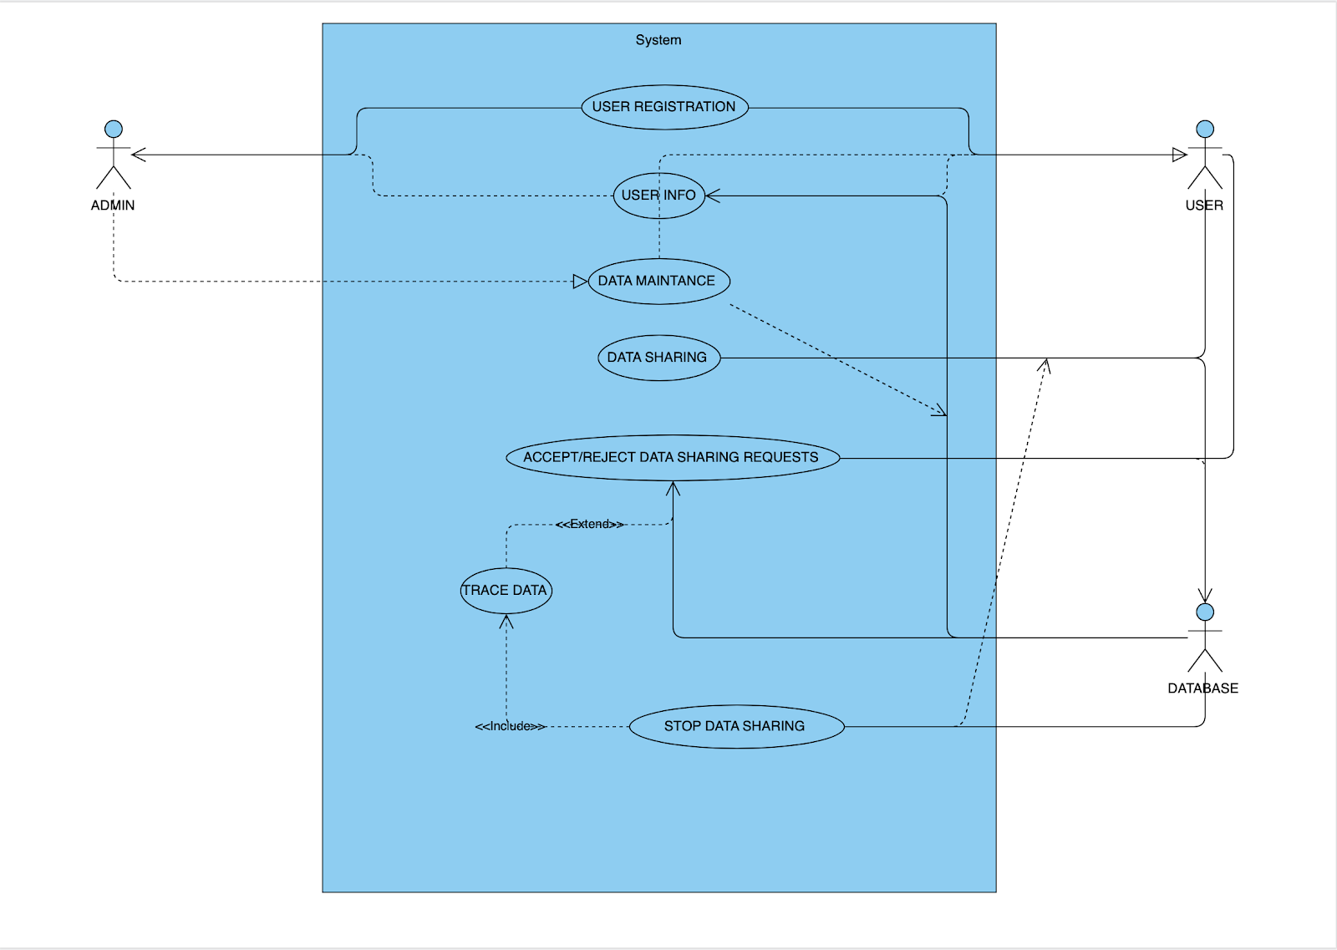
UML DIAGRAMS
SYSTEM OVERVIEW

Slide 21
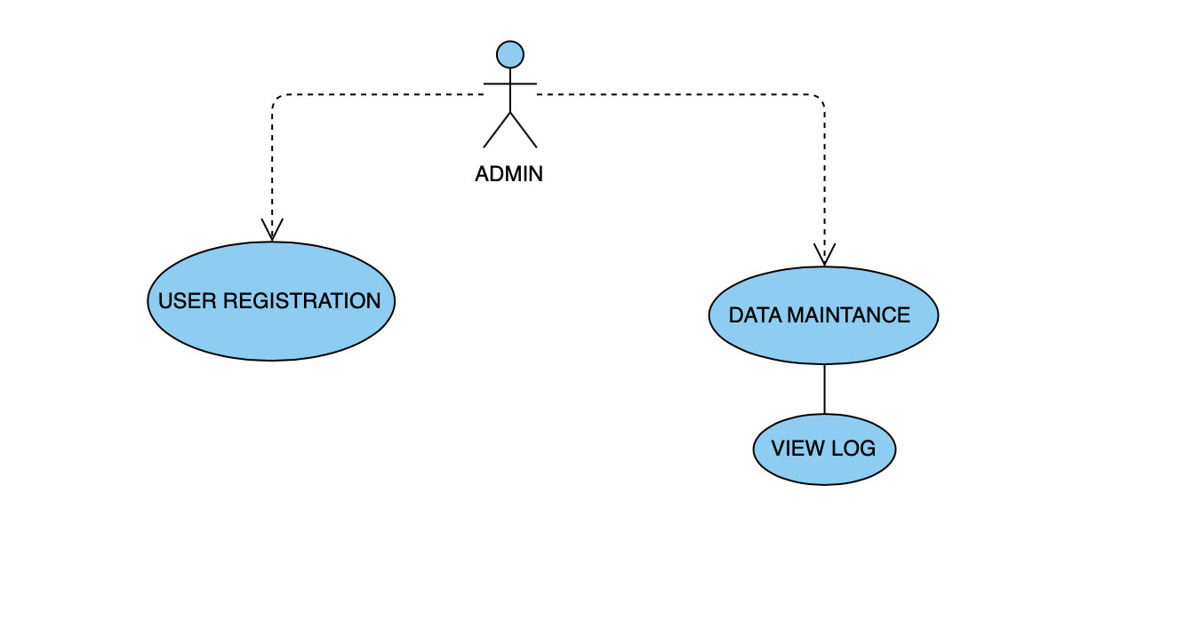
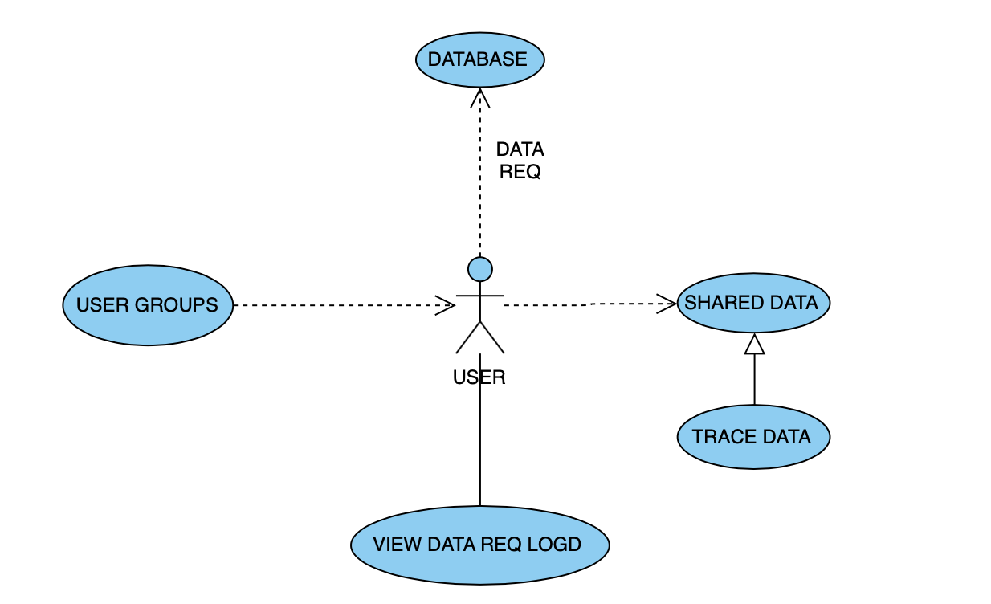
DIAGRAMS
Admin Use Case Diagram
User Use Case Diagram

Slide 22
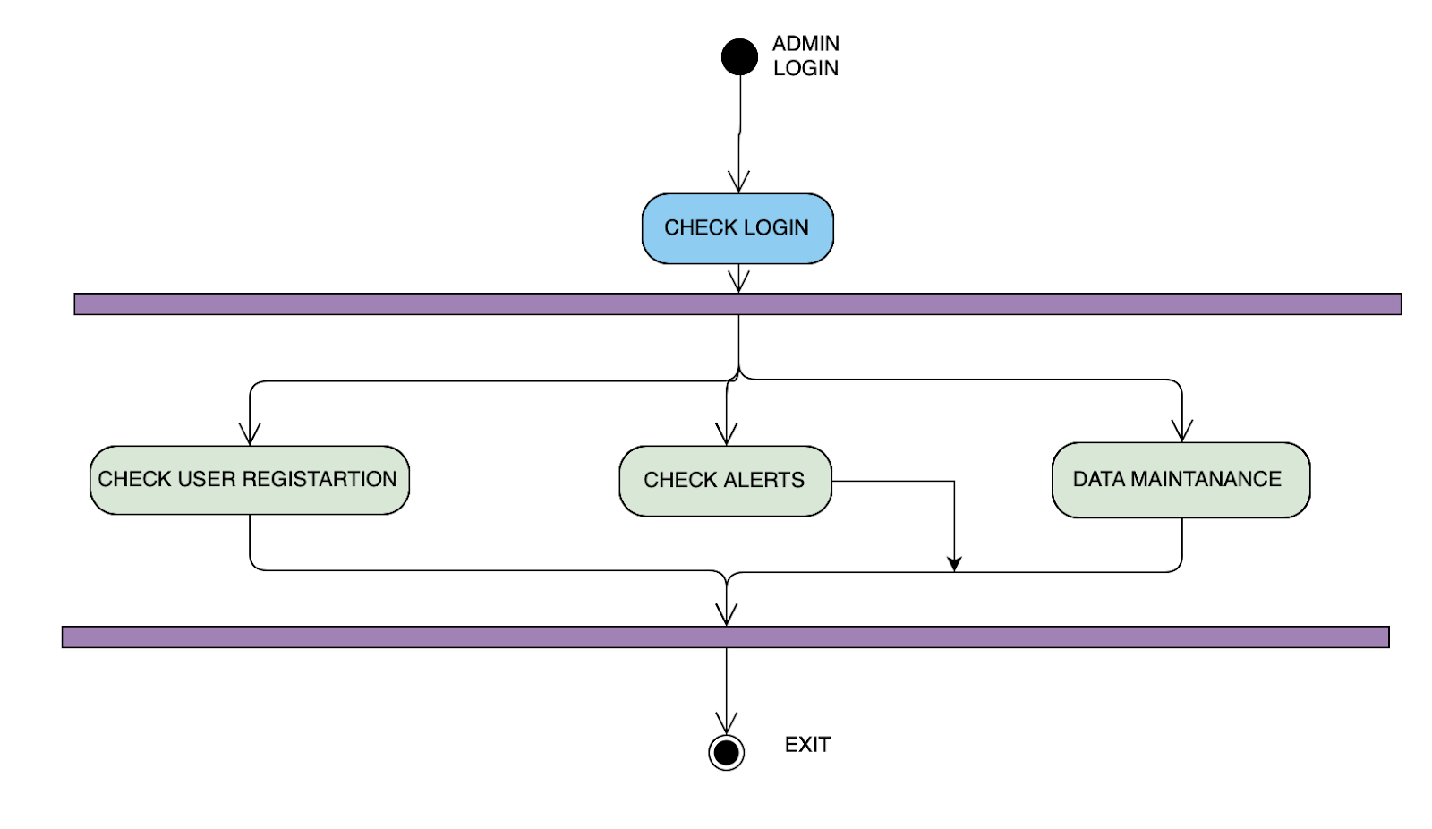
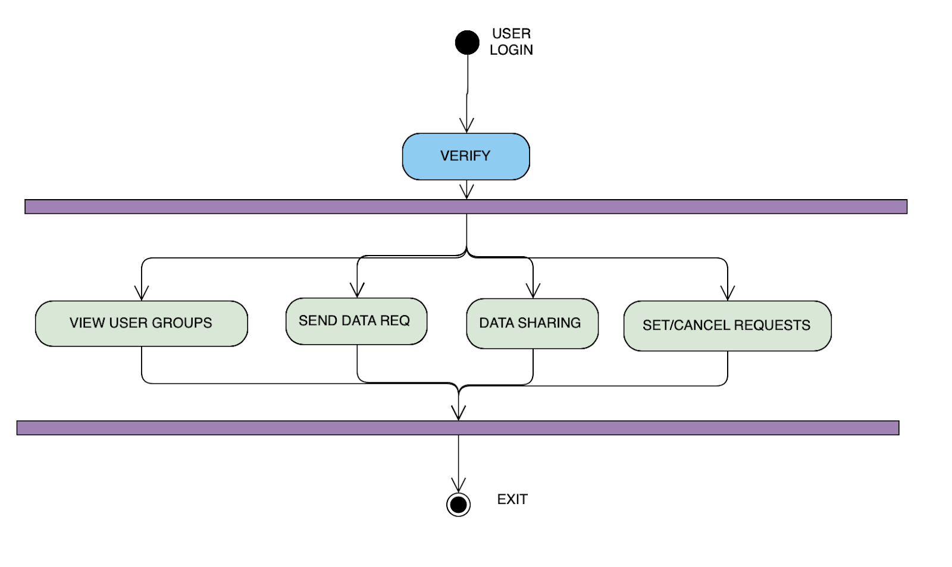
Admin Activity Diagram
User Activity Diagram

Slide 23
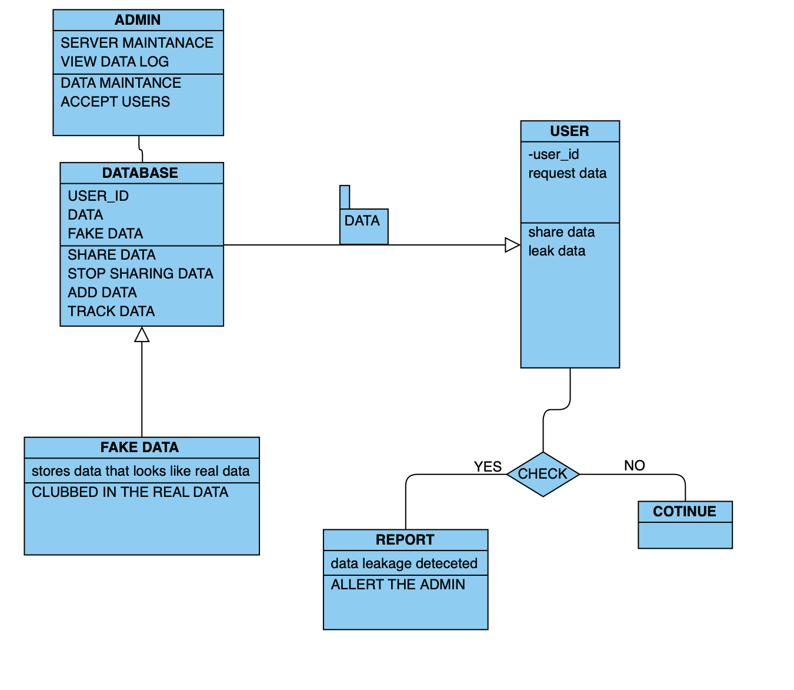
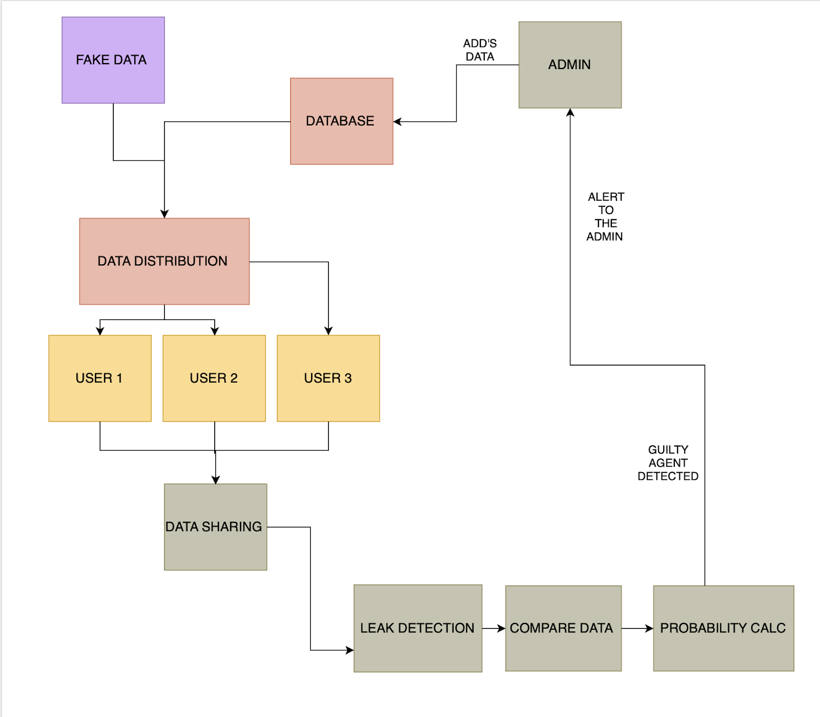
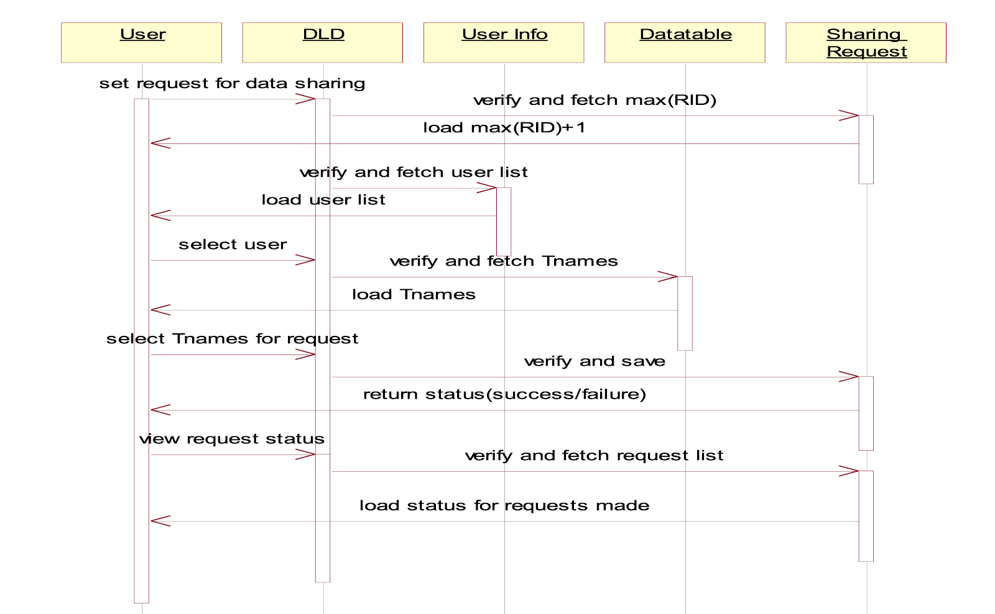
ADDITIONAL DIAGRAMS
Class Diagram
Sequence Diagram
Data Architecture

Slide 24


